Slide 1
D.R.A.P.E.S
What is it?
How will it improve my writing???

Slide 2
D.R.A.P.E.S
Have you ever gotten in the middle of writing something, then you can’t think of what to say next? You just kind of run out of steam?

Slide 3
D.R.A.P.E.S
Helps you plan your writing, so you never run out of things to say! It’s what Language Arts teachers call “elaboration”

Slide 4
D.R.A.P.E.S
You’re going to be amazed at
how DRAPES transforms your
writing! Let’s get started!

Slide 5
DRAPES
D=DIALOGUE
A quote or something an expert would say “Using DRAPES will help you become a better writer,” stated Mrs. Chambers, my Language Arts teacher.

Slide 6
DRAPES
R = RHETORICAL QUESTION
A question that is not meant to be answered.
“Who doesn’t want to
become a better writer?”
asked, Mrs. Chambers

Slide 7
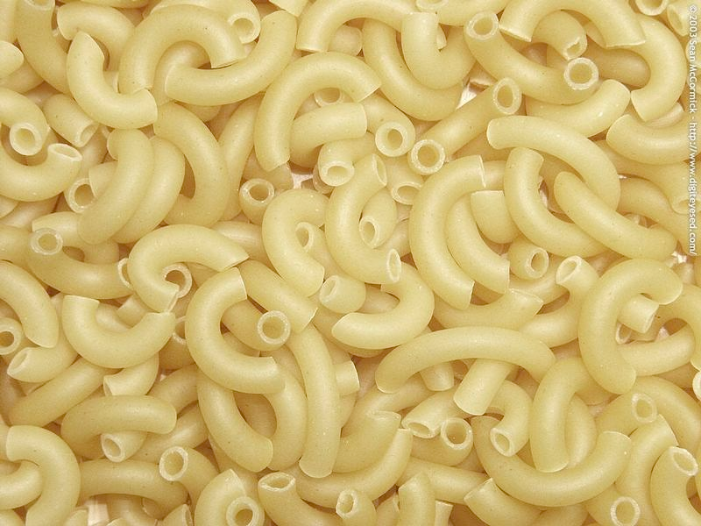
DRAPES
A = ANALOGY
A comparison through the use of figurative language
A piece of writing without
DRAPES is like macaroni
without cheese.

Slide 8
DRAPES
P= PERSONAL EXPERIENCE
Something you or someone you
know has had experience with.
Using personal experiences in your writing is the difference between 4s and 5s on your writing style grade!

Slide 9
DRAPES
E= Examples
Include an example of something
For example……
For instance……
Using examples paints a better picture for the reader

Slide 10
DRAPES
S = STATISTICS
A fact or data
Usually a percentage or number that supports your point in writing.
Example:
There has been a 30% increase in the scores since students started using DRAPES in their writing!

Slide 11
Have you used DRAPES in your writing?
D - Dialogue
R - Rhetorical Questions A- Analogies
P - Personal Experiences E - Examples S - Statistics

